Slide 1
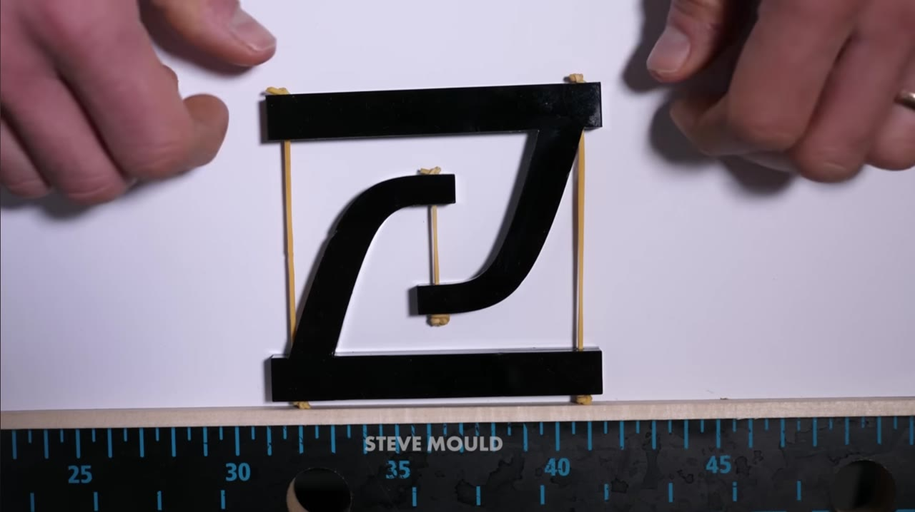
A tensegrity holds itself up with rigid struts that never touch, floating in a net of cables.
Steve Mould, “Tensegrity Explained” (youtube.com/watch?v=0onncd0_0-o) — 35 s excerpt, played with sound, used with on-screen credit.
Notes:
BACKGROUND, first beat. Play the whole 35 s with the sound up and stay quiet — the narration does the teaching, and the 2D model is the fastest way to make the mechanism obvious to anyone who has never seen a tensegrity.
Watch for: the model standing with nothing glued or hinged; the push; the spring back. That elastic return is the whole reason a tensegrity is interesting as an energy absorber.
Source: Box folder shared on PR #84 (youtube-0onncd0_0-o.mp4). Embedded locally — no internet needed at the podium.

Slide 2
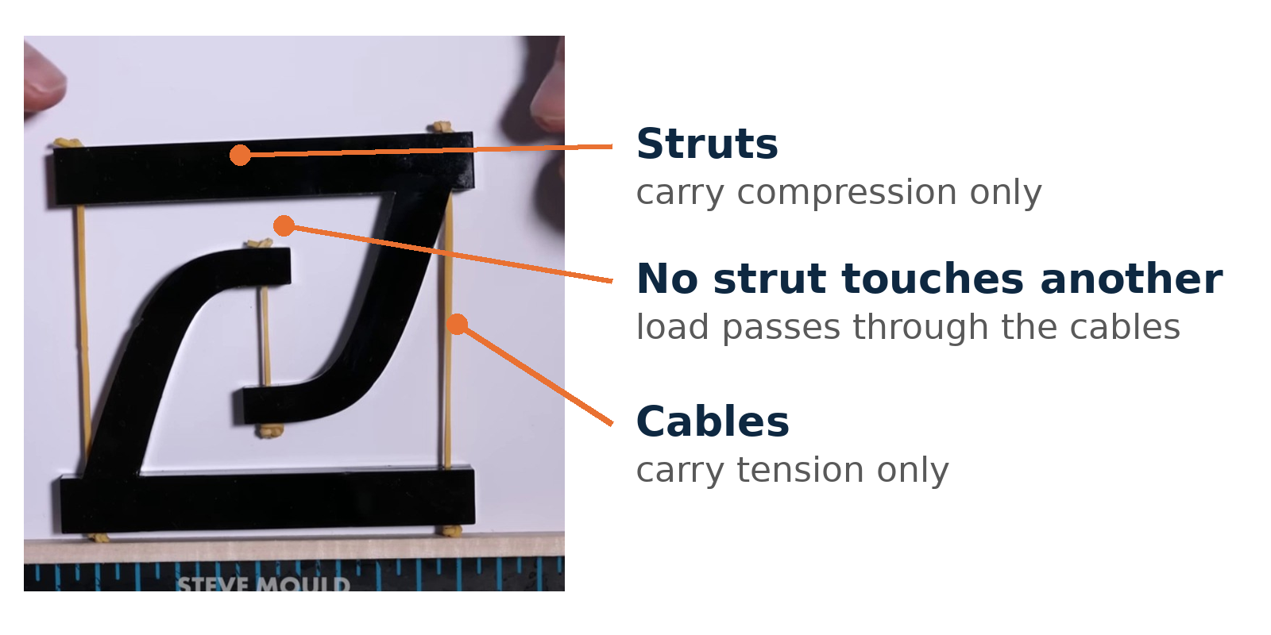
Every load path is either pure compression in a strut or pure tension in a cable — nothing in between.
Still from the same clip — Steve Mould, “Tensegrity Explained” (youtube.com/watch?v=0onncd0_0-o).
Notes:
BACKGROUND, second beat. Freeze the model and name the parts, so the vocabulary is in place before the caveat slide later on.
Say: this is why a tensegrity can be light and still stiff — no member ever sees a bending moment, and the cables set the stiffness. It is also why the geometry matters so much: change a strut length or a cable pre-tension and the whole response changes, which is exactly what makes it an optimization problem.
This is the mechanism visual the mock audience said the grad student needed in order to tell a tensegrity from a lattice.

Slide 3
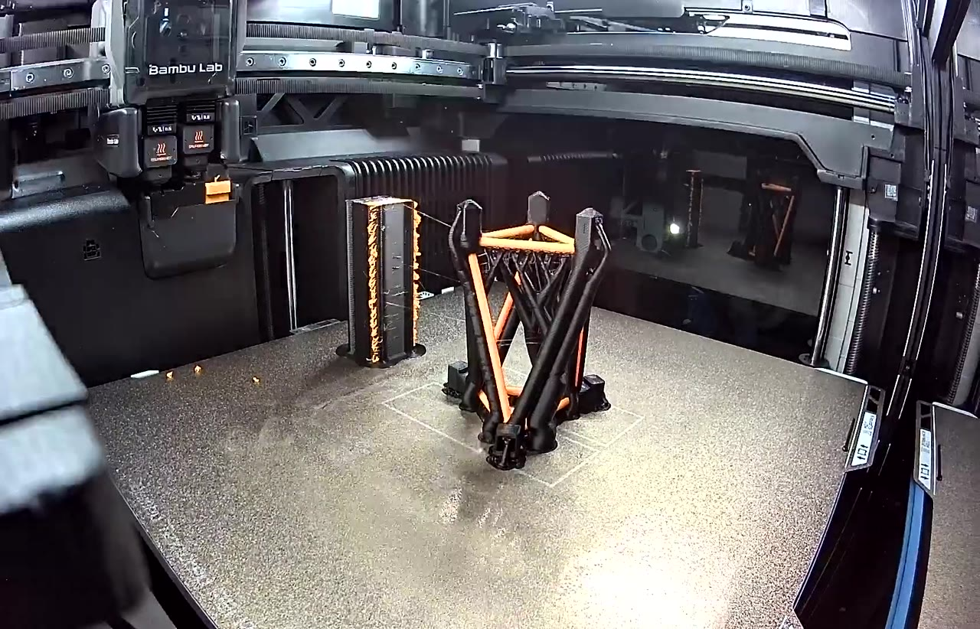
We print our version in one build: PLA struts and TPU members laid down together, with no assembly.
BYU Vertical Cloud Lab — 16 s timelapse of a T3 specimen (youtube.com/watch?v=nQNmi-NiL5I).
Notes:
BACKGROUND, third beat, and the bridge into the method: this is the object every later slide is about. Black is PLA (the struts), orange is TPU (the tension members); the tall column at the back is the purge tower the printer needs when it swaps filaments.
Say it in the same breath as the caveat slide: printed like this, the TPU members are not pre-tensioned and not inextensible, so these are tensegrity-INSPIRED structures, not true tensegrities. We are working on pre-tensioned prints and hand-built validation specimens (issue #87).
Downloaded from our own YouTube channel through the lab Raspberry Pi; the file is embedded, so it plays with no internet.

